Slide 1
Unit 1
Data Types & Collection

Slide 2
Out line
Types of Data
Attributes & Measurements
Types of Data Sets
Data Quality
Data Measurement and Data Collection Issues

Slide 3
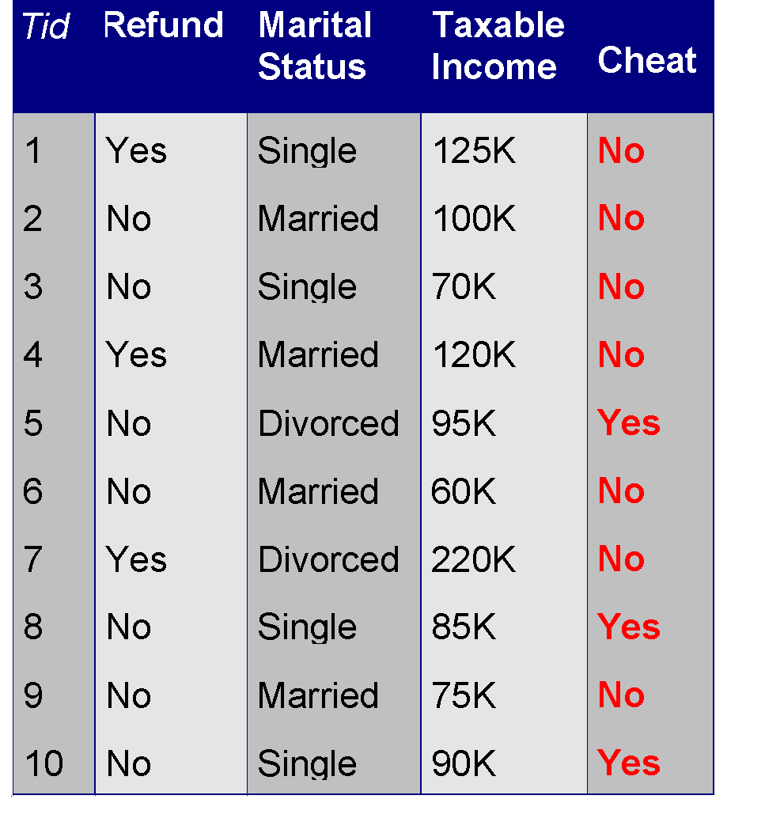
What is Data?
Collection of Data Objects and their Attributes
An attribute is a property or characteristic of an object that may vary, either from one objeect to another or from one time to another.
Examples: eye color of a person, temperature, etc.
Attribute is also known as variable, field, characteristic, dimension, or feature
A collection of attributes describe an object
Object is also known as record, point, case, sample, entity, or instance
Attributes
Objects

Slide 4
Attribute Values
Attribute values are numbers or symbols assigned to an attribute for a particular object
Distinction between attributes and attribute values
Same attribute can be mapped to different attribute values
Example: height can be measured in feet or meters
Different attributes can be mapped to the same set of values
Example: Attribute values for ID and age are integers
But properties of attribute values can be different

Slide 5
Measurement
A measurement scale is a rule (function) that associates a numerical or symbolic value with an attribute of an object.
For instance, we step on a bathroom scale to determine our weight, we classify someone as male or female, or we count the number of chairs in a room to see if there will be enough to seat all the people coming to a meeting.

Slide 6
In all these cases the "physical value" of an attribute of an object is mapped to a numerical or symbolic value.
With this background, we can now discuss the type of an attribute, a concept that is important in determining if a particular data analysis technique is consistent with a specific type of attribute.

Slide 7
Type of an attribute
The values used to represent an attribute may have properties that are not properties of the attribute itself, and vice versa
Example 1: Employee Age and ID Number
Example 2: Length of Line Segments

Slide 8
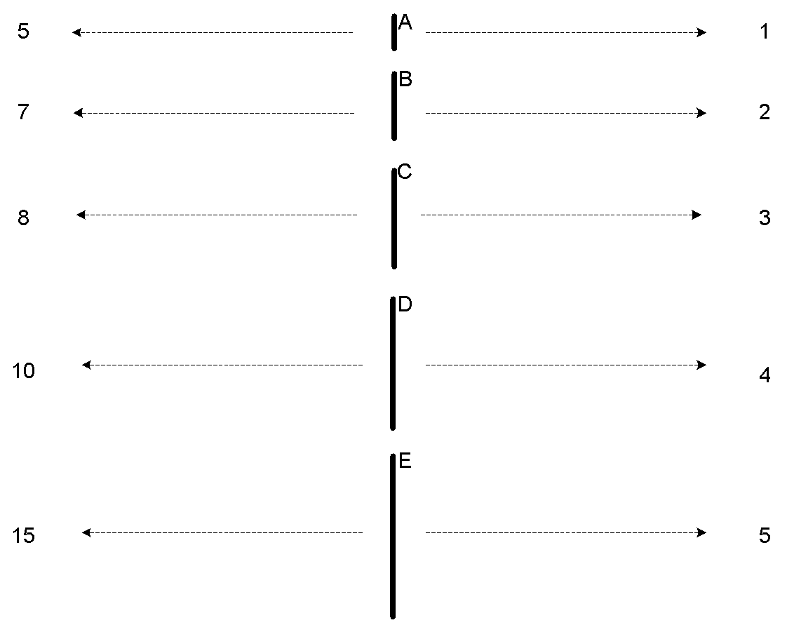
Example 2: Length of Line Segments
The way you measure an attribute may not match the attributes properties.
This scale preserves only the ordering property of length.
This scale preserves the ordering and additvity properties of length.

Slide 9
Properties of Attribute Values
The type of an attribute depends on which of the following properties/operations it possesses:
Distinctness : = and ≠
Order : < , <=, > and >=
Addition : + and -
(Meaningful Differences)
Multiplication : * and /
( Meaningful Differences)

Slide 10
Types of Attributes
There are 4 different types of attributes
Nominal
Examples: ID numbers, eye color, zip codes
Ordinal
Examples: rankings (e.g., taste of potato chips on a scale from 1-10), grades, height {tall, medium, short}
Interval
Examples: calendar dates, temperatures in Celsius or Fahrenheit.
Ratio
Examples: temperature in Kelvin, length, time, counts

Slide 11
Nominal attribute : distinctness
Ordinal attribute : distinctness & order
Interval attribute : distinctness, order & meaningful differences
Ratio attribute : all 4 properties/operations

Slide 12
Difference Between Ratio and Interval
Is it physically meaningful to say that a temperature of 10 ° is twice that of 5° on
the Celsius scale?
the Fahrenheit scale?
the Kelvin scale?
Consider measuring the height above average
If Bill’s height is three inches above average and Bob’s height is six inches above average, then would we say that Bob is twice as tall as Bill?
Is this situation analogous to that of temperature?

Slide 13
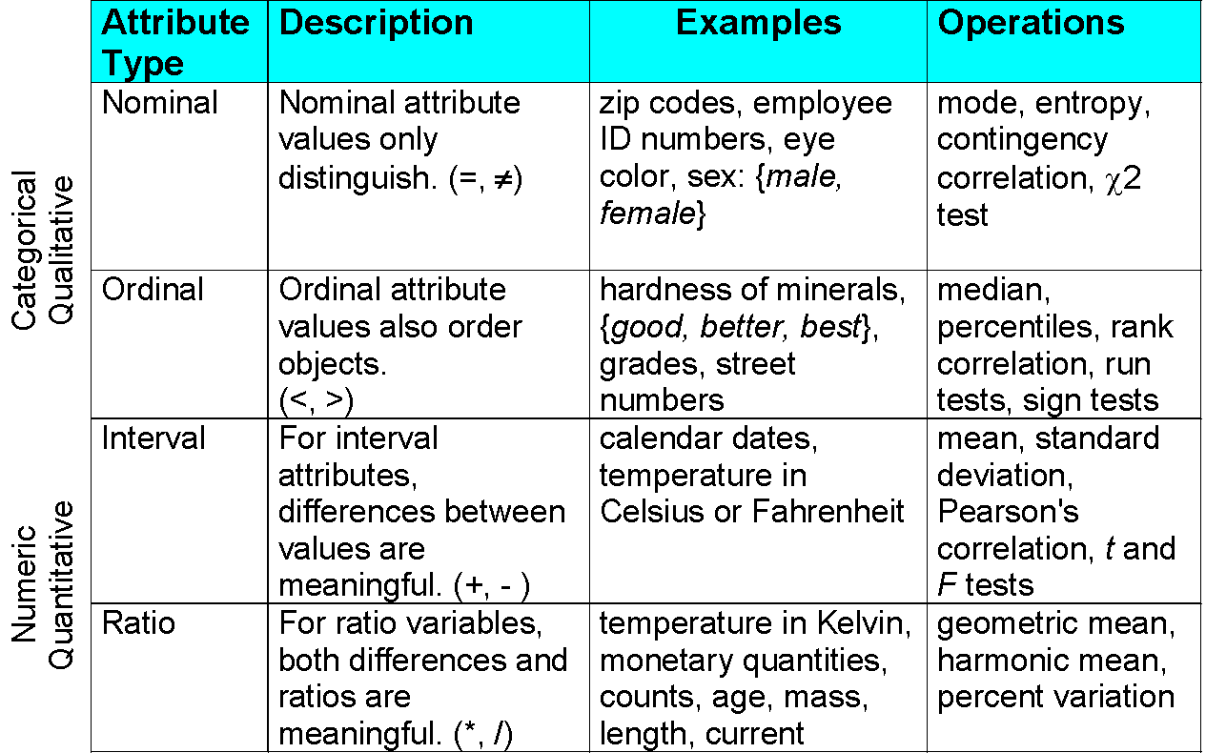

Slide 14
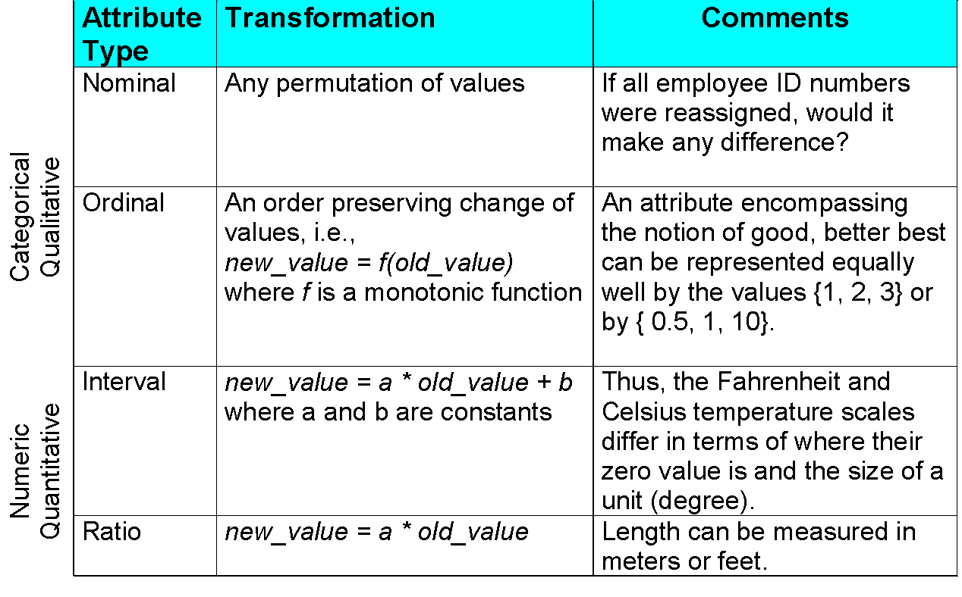

Slide 15
Discrete and Continuous Attributes
Classification algorithms developed from the field of machine learning often talk of attributes as being either discrete or continuous. Each type may be processed differently.
A discrete attribute has a finite or countably infinite set of values, which may or may not be represented as integers. The attributes hair color, smoker, medical test, and drink size each have a finite number of values, and so are discrete. Note that discrete attributes may have numeric values, such as 0 and 1 for binary attributes or, the values 0 to 110 for the attribute age. An attribute is countably infinite if the set of possible values is infinite but the values can be put in a one-to-one correspondence with natural numbers.
For example, the attribute customer ID is countably infinite. The number of customers can grow to infinity, but in reality, the actual set of values is countable (where the values can be put in one-to-one correspondence with the set of integers). Zip codes are another example.

Slide 16
If an attribute is not discrete, it is continuous. The terms numeric attribute and continuous attribute are often used interchangeably in the literature. (This can be confusing because, in the classic sense, continuous values are real numbers, whereas numeric values can be either integers or real numbers.) In practice, real values are represented using a finite number of digits. Continuous attributes are typically represented as floating-point variables.
Examples: temperature, height, or weight.

Slide 17
Binary Attribute
A binary attribute is a nominal attribute with only two categories or states: 0 or 1, where 0 typically means that the attribute is absent, and 1 means that it is present.
Binary attributes are referred to as Boolean if the two states correspond to true and false.
Example 2.2 Binary attributes. Given the attribute smoker describing a patient object, 1 indicates that the patient smokes, while 0 indicates that the patient does not. Similarly, suppose the patient undergoes a medical test that has two possible outcomes. The attribute medical test is binary, where a value of 1 means the result of the test for the patient is positive, while 0 means the result is negative.

Slide 18
Binary Attributes
A binary attribute is symmetric if both of its states are equally valuable and carry the same weight; that is, there is no preference on which outcome should be coded as 0 or 1. One such example could be the attribute gender having the states male and female.
A binary attribute is asymmetric if the outcomes of the states are not equally important, such as the positive and negative outcomes of a medical test for HIV. By convention, we code the most important outcome, which is usually the rarest one, by 1 (e.g., HIV positive) and the other by 0 (e.g., HIV negative).

Slide 19
Key Messages for Attribute Types
The types of operations you choose should be “meaningful” for the type of data you have
Distinctness, order, meaningful intervals, and meaningful ratios are only four properties of data
The data type you see – often numbers or strings – may not capture all the properties or may suggest properties that are not there
Analysis may depend on these other properties of the data
Many statistical analyses depend only on the distribution
Many times what is meaningful is measured by statistical significance
But in the end, what is meaningful is measured by the domain

Slide 20
Important Characteristics of Data
Dimensionality (number of attributes)
High dimensional data brings a number of challenges
Sparsity
Only presence counts
Resolution
Patterns depend on the scale
Size
Type of analysis may depend on size of data

Slide 21
What is Dimensionality?
The dimensionality of a data set is the number of attributes that the objects in the data set have.
In a particular data set if there are high number of attributes (also called high dimensionality), then it can become difficult to analyse such a data set.
When this problem is faced, it is referred to as Curse of Dimensionality.
In order to understand what the hell is this Curse of Dimensionality, we first need to understand the other two characteristics of Data.

Slide 22
What is Sparsity?
For some data sets, such as those with asymmetric features, most attributes of an object have values of 0; in many cases fewer than 1% of the entries are non-zero. Such a data is called sparse data or it can be said that the data set has Sparsity.

Slide 23
What is Resolution?
The patterns in the data depend on the level of resolution.
If the resolution is too fine, a pattern may not be visible or may be buried in noise; if the resolution is too coarse, the pattern may disappear.
For example, variations in atmospheric pressure on a scale of hours reflect the movement of storms and other weather systems. On a scale of months, such phenomena are not detectable.

Slide 24
Types of data sets
Record
Data Matrix
Document Data
Transaction Data
Graph
World Wide Web
Molecular Structures
Ordered
Spatial Data
Temporal Data
Sequential Data
Genetic Sequence Data

Slide 25

The most basic form of record data has no explicit relationship among records or data fields, and every record (object) has the same set of attributes. Record data is usually stored either in flat files or in relational databases.
There are a few variations of Record Data, which have some characteristic properties.
Data Matrix
Document Data
Transaction Data

Slide 26
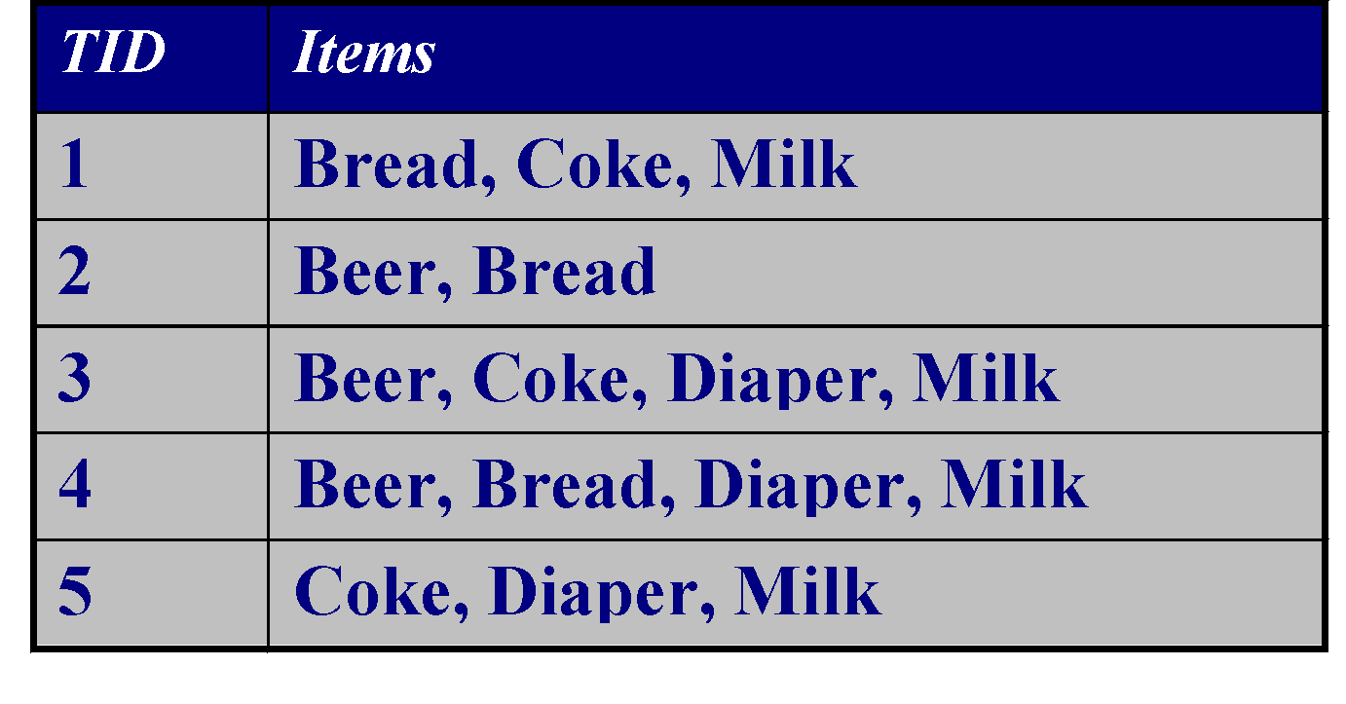
Transaction Data
Transaction or Market Basket Data: It is a special type of record data, in which each record contains a set of items. For example, shopping in a supermarket or a grocery store. For any particular customer, a record will contain a set of items purchased by the customer in that respective visit to the supermarket or the grocery store.
This type of data is called Market Basket Data. Transaction data is a collection of sets of items, but it can be viewed as a set of records whose fields are asymmetric attributes. Most often, the attributes are binary, indicating whether or not an item was purchased or not.

Slide 27
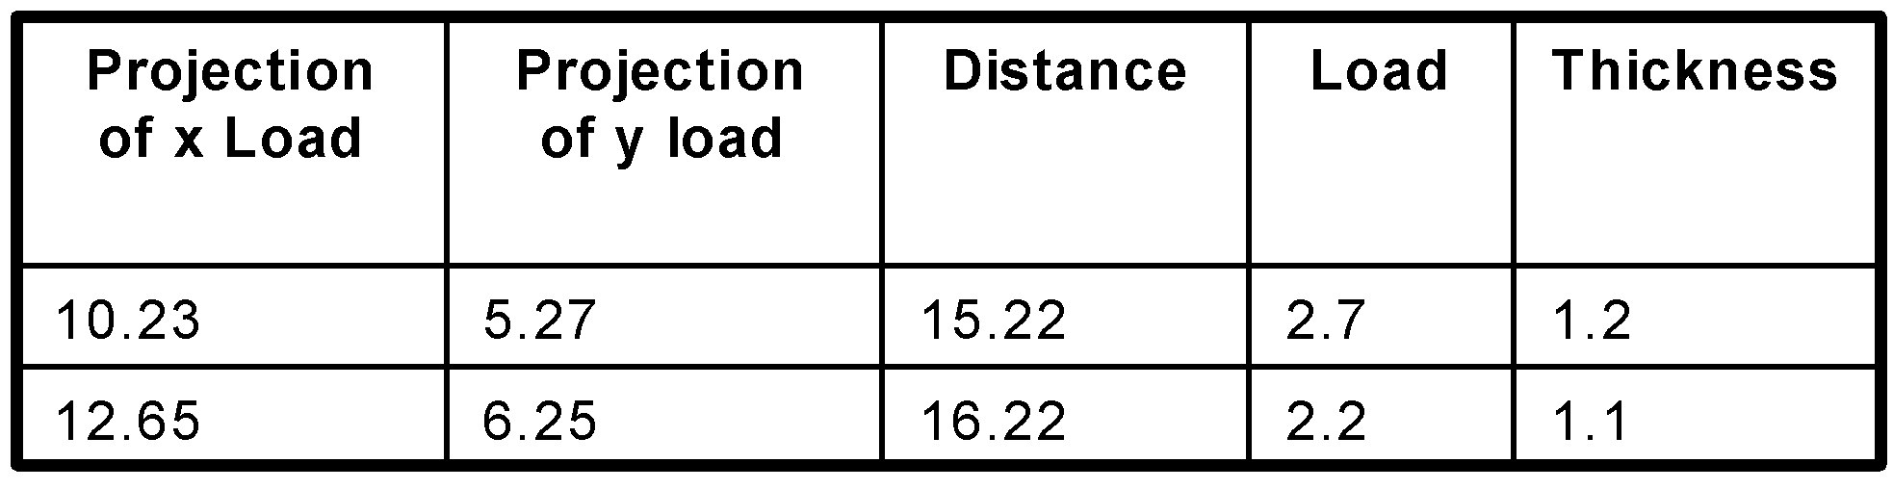
Data Matrix
If the data objects in a collection of data all have the same fixed set of numeric attributes, then the data objects can be thought of as points (vectors)in a multidimensional space, where each dimension represents a distinct attribute describing the object.
A set of such data objects can be interpreted as an m X n matrix, where there are n rows, one for each object, and n columns, one for each attribute. Standard matrix operation can be applied to transform and manipulate the data. Therefore, the data matrix is the standard data format for most statistical data.

Slide 28
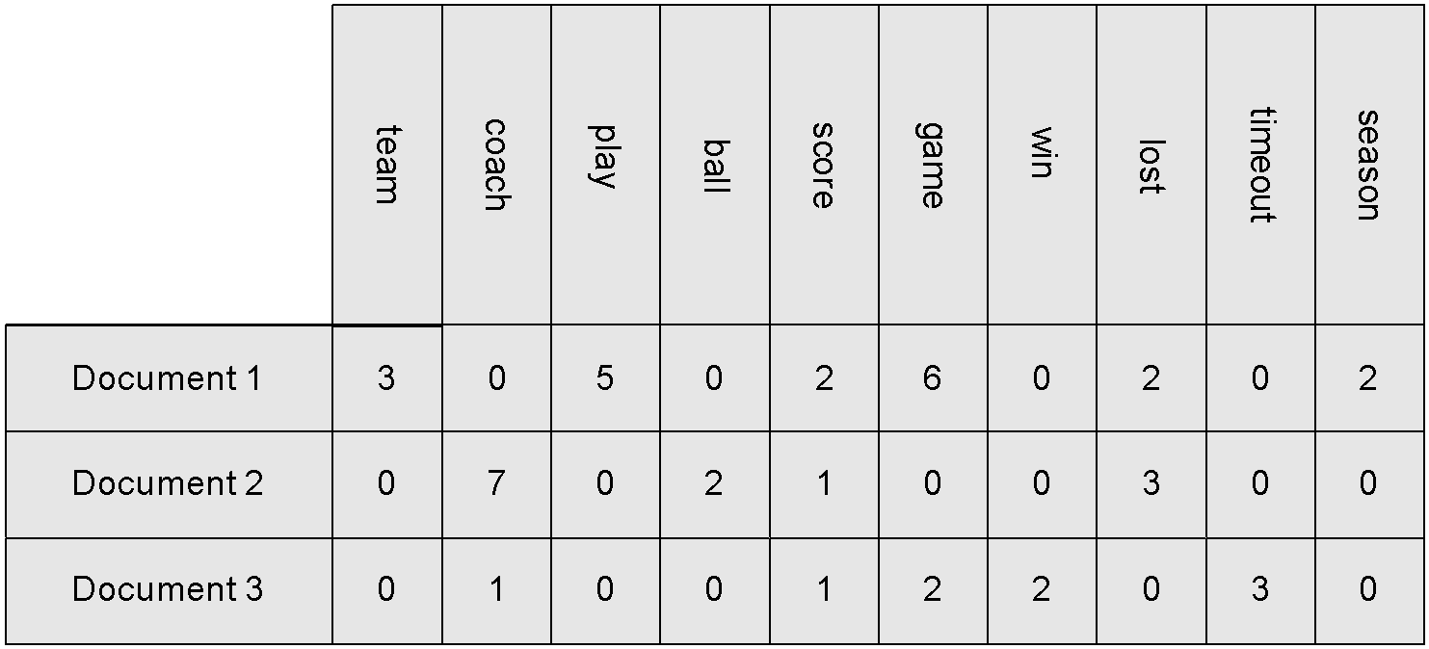
Document Data matrix or Spare data matrix
Each document becomes a ‘term’ vector
Each term is a component (attribute) of the vector
The value of each component is the number of times the corresponding term occurs in the document.
A special case of a data matrix in which the attributes are of the same type and are asymmetric; i.e., only non-zero values are important.

Slide 29
Graph Based Data
1, Data with Relationships among objects
ex: Linked Web pages
2, Data with Objects that are Graphs
ex: Molecule

Slide 30
Data with Relationships among Objects:
The data objects are mapped to nodes of the graph, while the relationships among objects are captured by the links between objects and link properties, such as direction and weight.
Consider Web pages on the World Wide Web, which contain both text and links to other pages. In order to process search queries, Web search engines collect and process Web pages to extract their contents.

Slide 31
Data with Objects That Are Graphs:
If objects have structure, that is, the objects contain sub objects that have relationships, then such objects are frequently represented as graphs.
For example, the structure of chemical compounds can be represented by a graph, where the nodes are atoms and the links between nodes are chemical bonds.

Slide 32
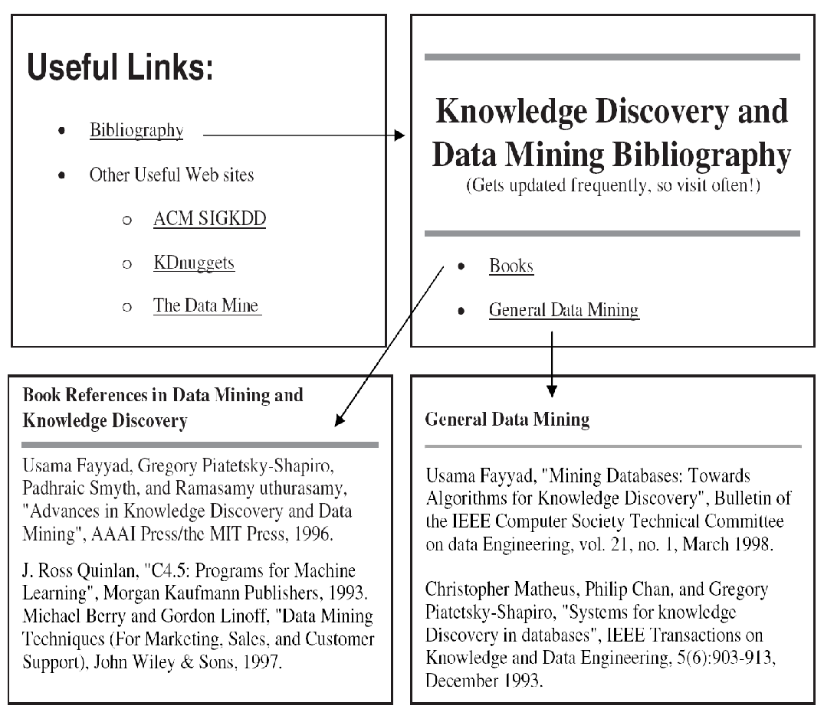
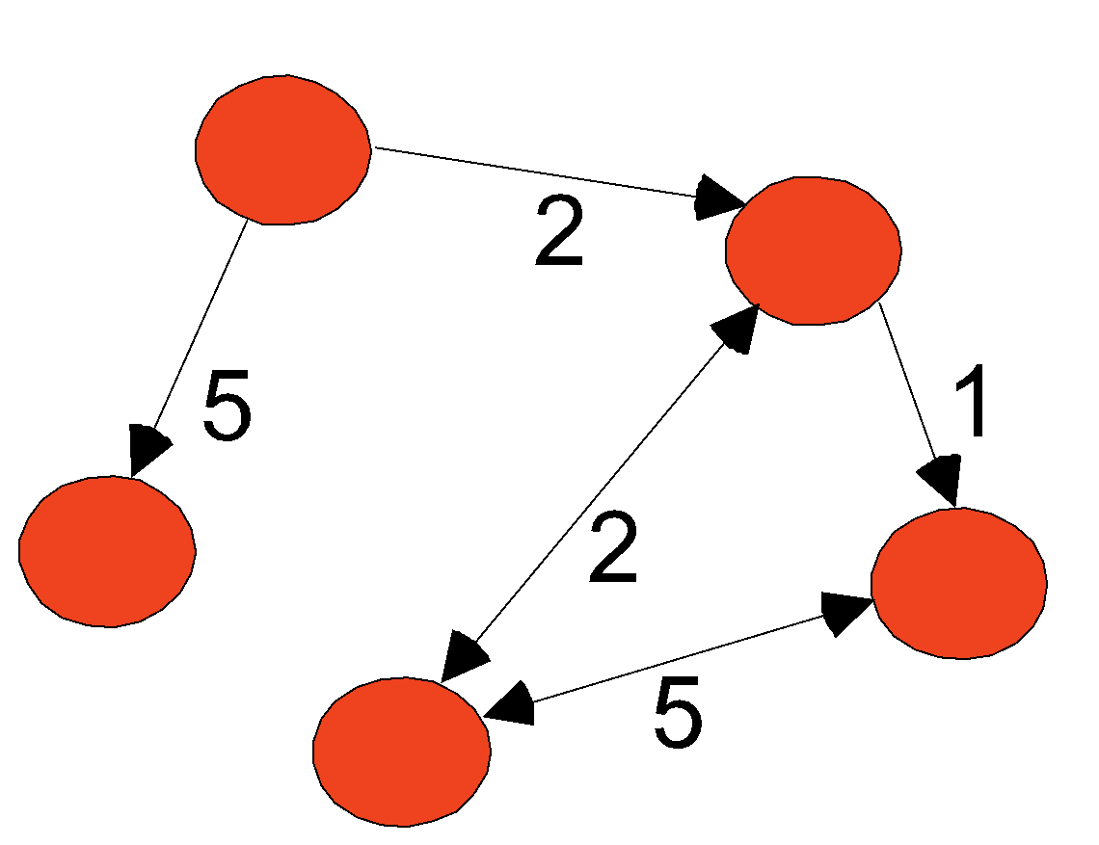
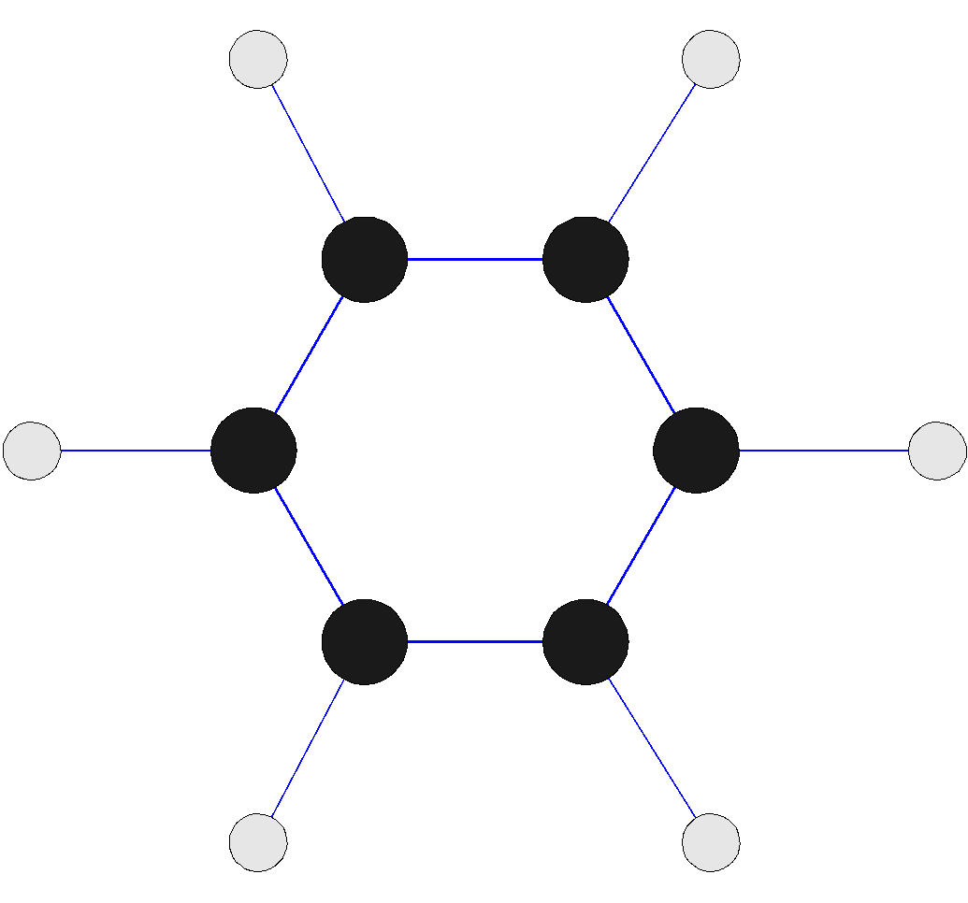
Graph Data
Examples: Generic graph, a molecule, and webpages
Benzene Molecule: C6H6

Slide 33
Ordered Data
For some types of data, the attributes have relationships that involve order in time or space. It can be segregated into four types:
Sequential Data
Sequence Data
Time Series Data
Spatial Data

Slide 34
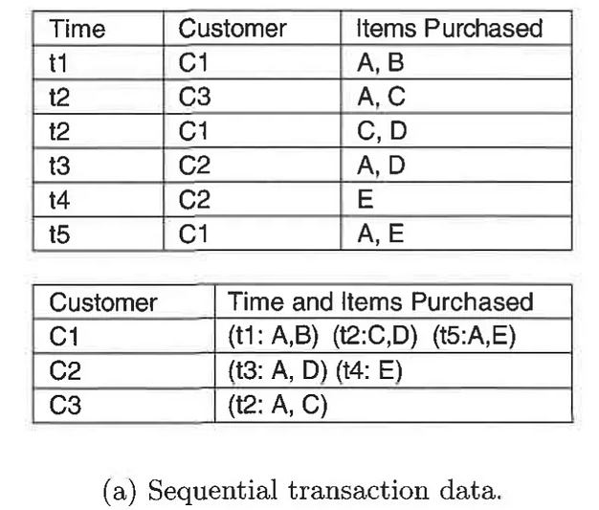
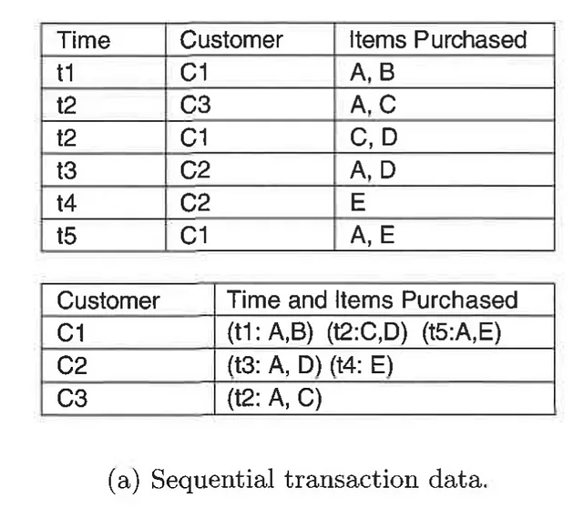
Ordered Data
Sequential Data : Also referred as temporal data
Sequences of transactions. Also can be thought of as an extension of record data, where each record has a time associated with it. Consider a retail transaction data set that also stores the time at which the transaction took place

Slide 35
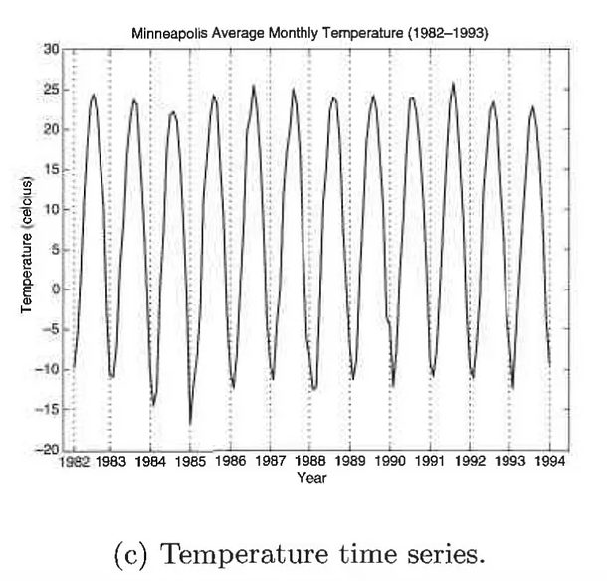
Time Series Data: Time series data is a special type of sequential data in which each record is a time series, i.e., a series of measurements taken over time. For example, a financial data set might contain objects that are time series of the daily prices of various stocks.

Slide 36
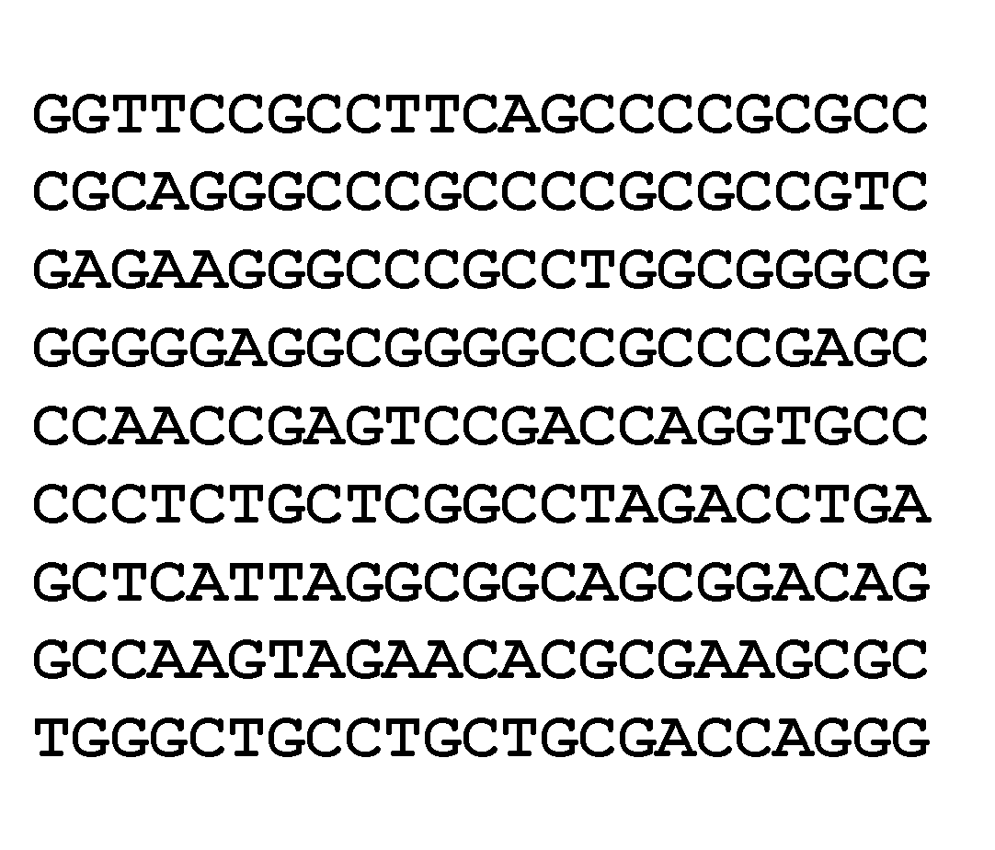
Ordered Data
Sequence Data: Ex: Genome sequencing. Sequence data consists of a data set that is a sequence of individual entities, such as a sequence of words or letters. It is quite similar to sequential data, except that there are no time stamps; instead, there are positions in an ordered sequence. For example, the genetic information of plants and animals can be represented in the form of sequences of nucleotides that are known as genes.

Slide 37
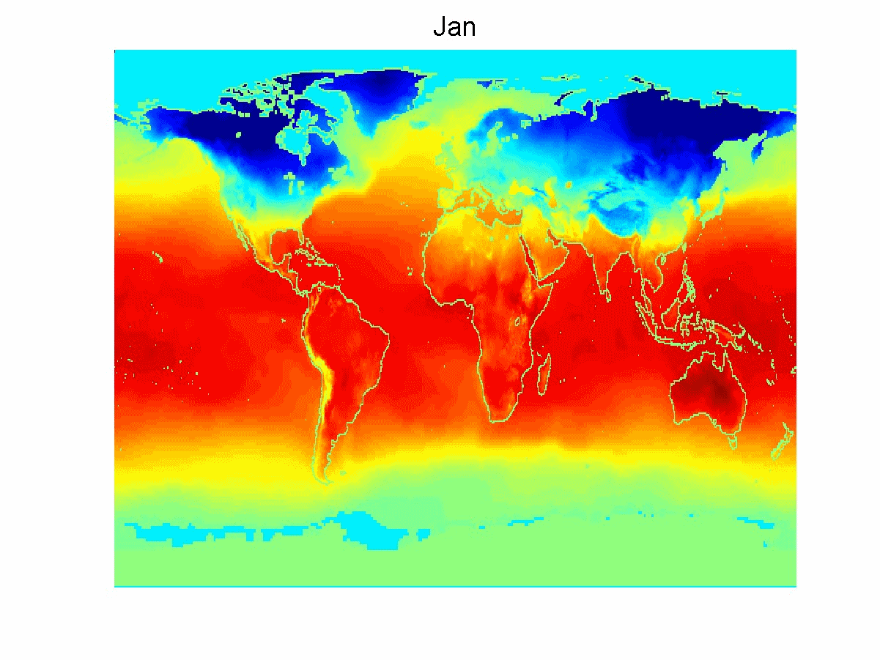
Ordered Data
Spatio-Temporal Data
Average Monthly Temperature of land and ocean
Spatial Data: Some objects have spatial attributes, such as positions or areas, as well as other types of attributes. An example of spatial data is weather data (precipitation, temperature, pressure) that is collected for a variety of geographical locations.

Slide 38
Data Quality
Poor data quality negatively affects many data processing efforts
“The most important point is that poor data quality is an unfolding disaster.
Poor data quality costs the typical company at least ten percent (10%) of revenue; twenty percent (20%) is probably a better estimate.”
Thomas C. Redman, DM Review, August 2004
Data mining example: a classification model for detecting people who are loan risks is built using poor data
Some credit-worthy candidates are denied loans
More loans are given to individuals that default

Slide 39
Data Quality …
What kinds of data quality problems?
How can we detect problems with the data?
What can we do about these problems?
Examples of data quality problems:
Noise and outliers
Missing values
Duplicate data
Wrong data

Slide 40
Measurement and Data Collection Errors
The term Measurement Error refers to any problem resulting from the measurement process.
A common problem is that the value recorded differs from the true value to some extent.
For continuous attributes, the numerical difference of the measured and true value is called the error.
The term Data Collection Error refers to errors such as omitting data objects or attribute values, or inappropriately including a data object.
For example, a study of animals of a certain species might include animals of a related species that are similar in appearance to the species of interest.

Slide 41
Noise and Artifacts
Noise is the random component of a measurement error. It may involve the distortion of a value or the addition of spurious objects.
The term noise is often used in connection with data that has a spatial or temporal component.
In such cases, techniques from signal or image processing can frequently be used to reduce noise and thus, help to discover patterns (signals) that might be "lost in the noise."
Nonetheless, the elimination of noise is frequently difficult, and much work in data mining focuses on devising robust algorithms that produce acceptable results even when noise is present.

Slide 42
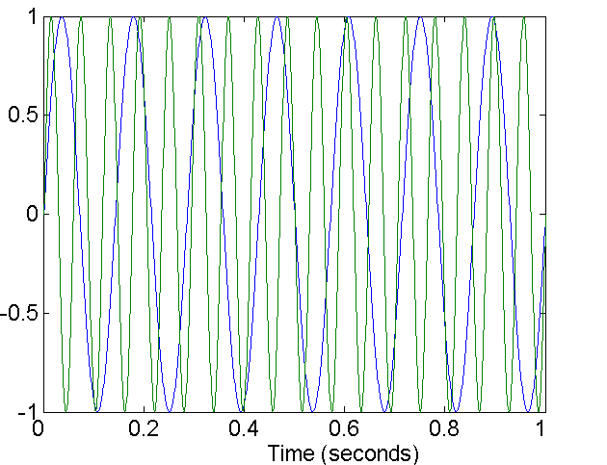
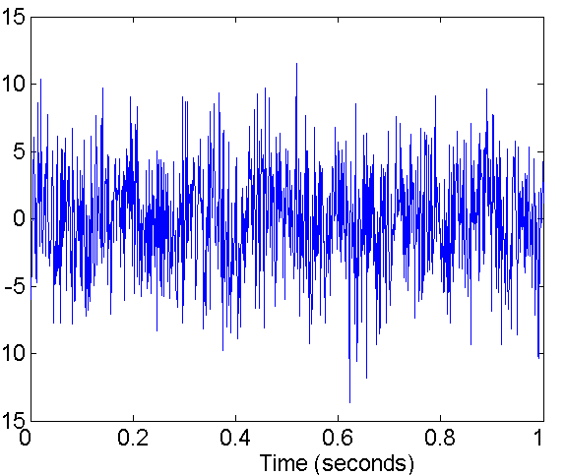
Noise
For objects, noise is an extraneous object
For attributes, noise refers to modification of original values
Examples: distortion of a person’s voice when talking on a poor phone and “snow” on television screen
Two Sine Waves
Two Sine Waves + Noise

Slide 43
Data errors may be the result of a more deterministic phenomenon, such as a streak in the same place on a set of photographs. Such deterministic distortions of the data are often referred to as artifacts.
A data artifact is a data flaw caused by equipment, techniques or conditions.
Common sources of data flaws include hardware or software errors, conditions such as electromagnetic interference and flawed designs such as an algorithm prone to miscalculations

Slide 44
Precision, Bias, and Accuracy
Precision: The closeness of repeated measurements (of the same quantity) to one another.
Precision is often measured by the standard deviation of a set of values
Bias: A systematic quantity being measured.
Bias is measured by taking the difference between the mean of the set of values and the known value of the quantity being measured.
Bias can only be determined for objects whose measured quantity is known by means external to the current situation

Slide 45
For example: Suppose that we have a standard laboratory weight with a mass of 1g and want to assess the precision and bias of our new laboratory scale.
We weigh the mass five times, and obtain the following five values: {1.015,0.990, 1.013, 1.001,0.986}.
The mean of these values is 1.001, and hence, the bias is 0.001. The precision, as measured by the standard deviation, is 0.013.
Accuracy: The closeness of measurements to the true value of the quantity being measured.
Accuracy depends on precision and bias, but since it is a general concept, there is no specific formula for accuracy in terms of these two quantities

Slide 46
Outliers
Outliers are either (1) data objects that, in some sense, have characteristics that are different from most of the other data objects in the data set, or (2) values of an attribute that are unusual with respect to the typical values for that attribute.
It is important to distinguish between the notions of noise and outliers.
Outliers can be legitimate data objects or values. Thus, unlike noise, outliers may sometimes be of interest.
In fraud and network intrusion detection, for example, the goal is to find unusual objects or events from among a large number of normal ones.

Slide 47
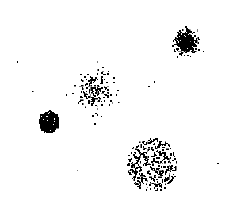
Outliers
Outliers are data objects with characteristics that are considerably different than most of the other data objects in the data set
Case 1: Outliers are noise that interferes with data analysis
Case 2: Outliers are the goal of our analysis
Credit card fraud
Intrusion detection
Causes?

Slide 48
Missing Values
It is not unusual for an object to be missing one or more attribute values.
In some cases, the information was not collected; e.g., some people decline to give their age or weight.
In other cases, some attributes are not applicable to all objects; e.g., often, forms have conditional parts that are filled out only when a person answers a previous question in a certain way, but for simplicity, all fields are stored.
Regardless, missing values should be taken into account during the data analysis.

Slide 49
Eliminate Data Objects or Attributes
A simple and effective strategy is to eliminate objects with missing values.
However, even a partially specified data object contains some information, and if many objects have missing values, then a reliable analysis can be difficult or impossible.
Nonetheless, if a data set has only a few objects that have missing values, then it may be expedient to omit them.
A related strategy is to eliminate attributes that have missing values. This should be done with caution, however, since the eliminated attributes may be the ones that are critical to the analysis.

Slide 50
Estimate Missing Values
Sometimes missing data can be reliably estimated.
For example, consider a time series that changes in a reasonably smooth fashion, but has a few, widely scattered missing values.
In such cases, the missing values can be estimated (interpolated) by using the remaining values.
As another example, consider a data set that has many similar data points. In this situation, the attribute values of the points closest to the point with the missing value are often used to estimate the missing value.

Slide 51
If the attribute is continuous, then the average attribute value of the nearest neighbors is used.
If the attribute is categorical, then the most commonly occurring attribute value can be taken.
For a concrete illustration, consider precipitation measurements that are recorded by ground stations. For areas not containing a ground station, the precipitation can be estimated using values observed at nearby ground stations..

Slide 52
Inconsistent Values
Data can contain inconsistent values. Consider an address field, where both a zip code and city are listed, but the specified zip code area is not contained in that city.
It may be that the individual entering this information transposed two digits, or perhaps a digit was misread when the information was scanned from a handwritten form.
Some types of inconsistencies are easy to detect. For instance, a person's height should not be negative.
In other cases, it can be necessary to consult an external source of information.

Slide 53
For example, when an insurance company processes claims for reimbursement, it checks the names and addresses on the reimbursement forms against a database of its customers.
A product code may have "check" digits, or it may be possible to double-check a product code against a list of known product codes, and then correct the code if it is incorrect, but close to a known code. The correction of an inconsistency requires additional or redundant information.

Slide 54
Duplicate Data
A data set may include data objects that are duplicates, or almost duplicates, of one another.
Many people receive duplicate mailings because they appear in a database multiple times under slightly different names.
To detect and eliminate such duplicates, two main issues must be addressed.
First, if there are two objects that actually represent a single object, then the values of corresponding attributes may differ, and these inconsistent values must be resolved.

Slide 55
Second, care needs to be taken to avoid accidentally combining data objects that are similar, but not duplicates, such as two distinct people with identical names.
In some cases, two or more objects are identical with respect to the attributes measured by the database, but they still represent different objects.
Here, the duplicates are legitimate, but may still cause problems for some algorithms if the possibility of identical objects is not specifically accounted for in their design

